Slide 1

Brief Introduction to Augmented Reality
UNIVERSITY OF ILLINOIS AT URBANA-CHAMPAIGN

Slide 2
Acknowledgments
Some material taken from :
Augmented Reality: Applications in Manufacturing and Maintenance
by SUN Jing
Aela GOURLAOUEN
QIU Zhi
Francois LEROY
Rostislav DOGANOV
Thomas Joseph Traviño SEVILLA

Slide 3

What Is Augmented Reality (AR)?
AR combines a real scene augmented by
a virtual objects generated by a computer that provide with additional information.

Slide 4
Augmented Reality and Mixed Reality and Virtual Reality
AR
System augments the real world scene with virtual elements
Needs a mechanism to combine virtual and real worlds
Hard to register real and virtual worlds
MR
Like AR but you can interact with the virtual element
VR
Totally immersive synthetic environment
Need a mechanisms to generate fully synthetic environment
Hard to provide consistent stimuli
Notes:
Computer generated virtual objects must be accurately registers with the real
in all dimensions.
Errors in registration prevent the real and virtual images from being seen as fused.
Registration must be maintained while the user moves around in the virtual
environment.
Changes in registration can be distracting or physically disturbing.

Slide 5
AR Displays

Slide 6
AR Applications in Training and Assembly

Slide 7
Training and Assembly: Duplo Blocks Case Study

Slide 8
Training and Assembly: Duplo Blocks Case Study

Slide 9
Maintenance

Slide 10
Tracking and Registration

Slide 11
Tracking and Registration

Slide 12

State of the Art The HoloLens 2
Released in 2019
$3500
Designed for industry, not consumers
Projects images onto glass lenses which reflect to eye

Slide 13
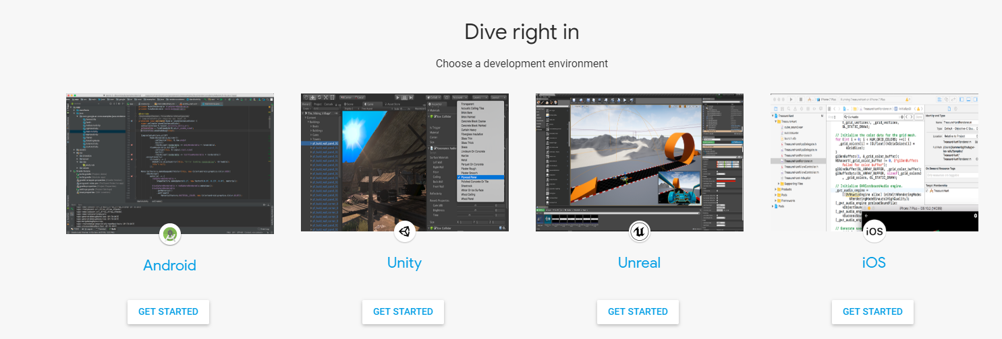
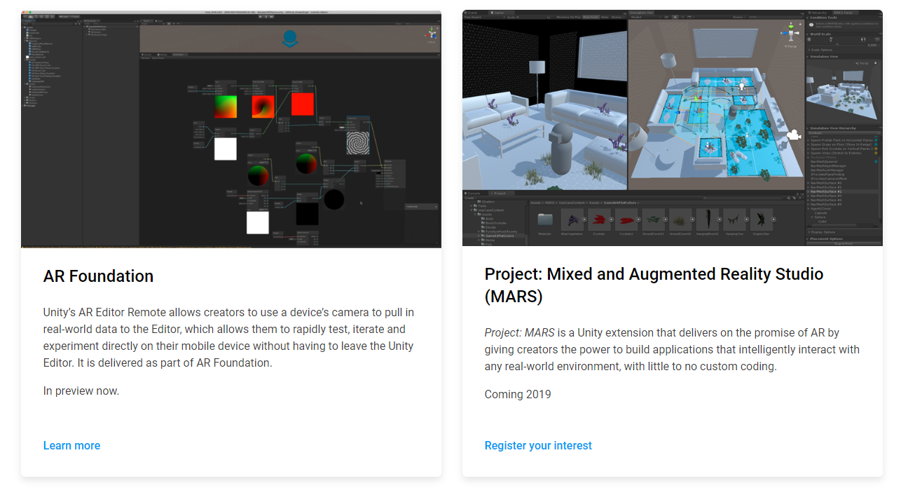
AR Software Development
Google provides ARCore
Unity will provide AR Foundation
For now…Vuforia is the best Unity option

Slide 14
A Few Closing Thoughts…
Using Unity to teach programming has both pros and cons
Negatives
It takes time to get used to the Unity IDE
You can’t develop on a ChromeBook (although you can play games on one)
Positives
People want to make games/art etc. that looks good…strong motivation
Vocationally, using an IDE and working with existing code is what most developers do
Lots of support/resources online
Still get to teach classic coding (iteration, branching, functions,…)

